Slide 1
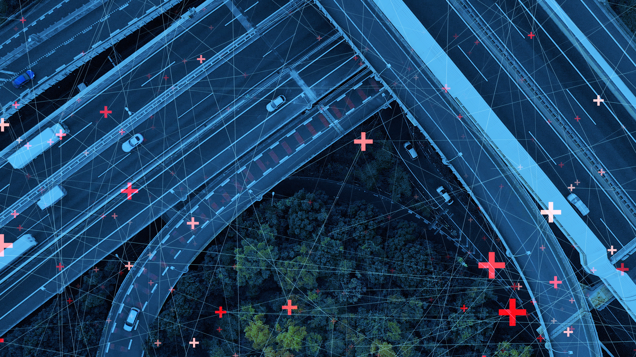
MHP mobility hack
Sustainable smart traffic light

Slide 2

Introductions

Slide 3
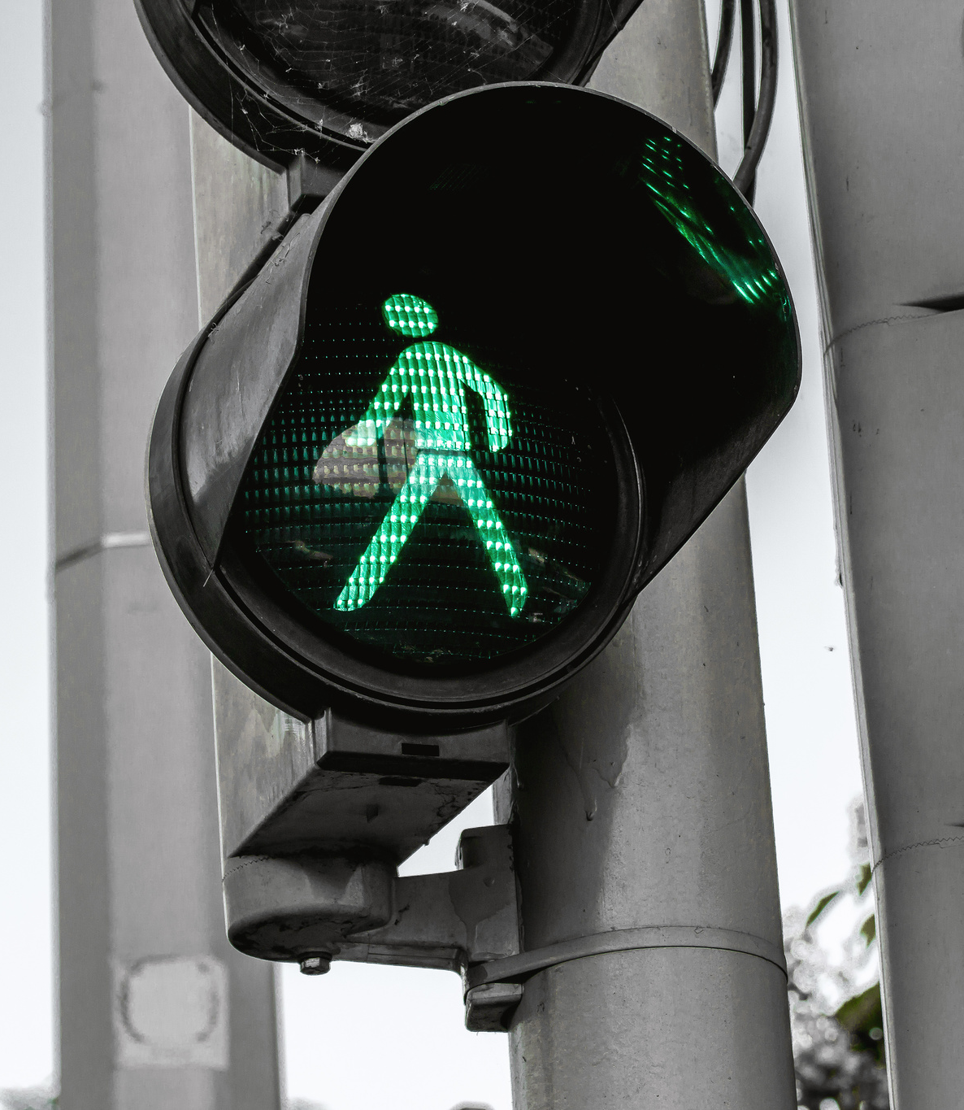
The challenge
3 days
Use any tool you see fit
Write software to be able to intelligently control a traffic light to be able to further sustainability, relieve traffic, and improve the lives of people driving the cars and around
Previously developed software can be used, but it must be made clear what was previously developed and what was developed now

Slide 4

presentations
5-minute presentation to present your solution
1 member per team
Submission deadline by 10 a.m. on Sunday
The submission must include anything you would like to utilize to present, i.e. Powerpoint
Submit link to Github repository or all code that you used for the challenge

Slide 5

questions

